Slide 1
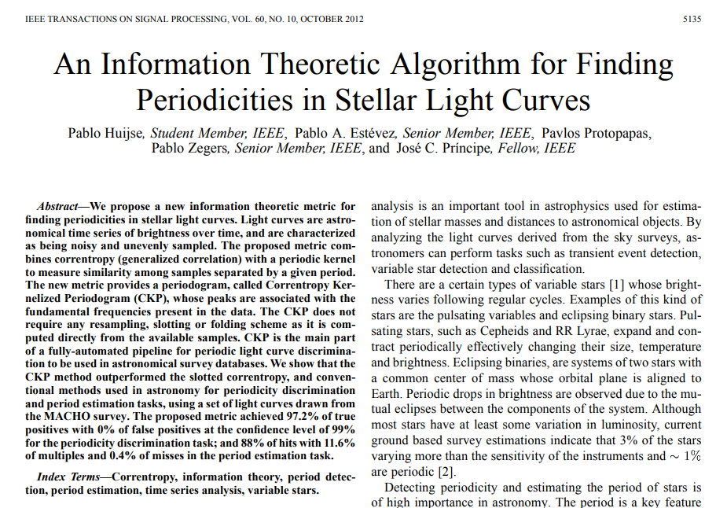
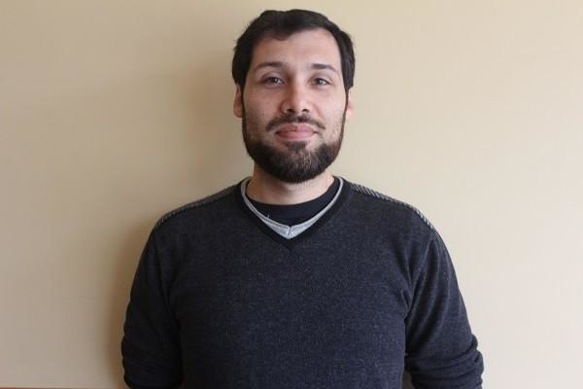
HOMEWORK 7
An Information Theoretic Algorithm
Pablo Huijse

